Slide 1
2019 TRB Transportation Planning Application Conference
Development of An Enhanced and Efficient Traffic Forecasting Tool (TFT)
Johnny Han, Corradino
Akbar Bakhshi, Corradino
Greg Katter, Indiana Department of Transportation
Korey Chu, Indiana Department of Transportation
Roy Nunnally, Indiana Department of Transportation
June 4, 2019

Slide 2
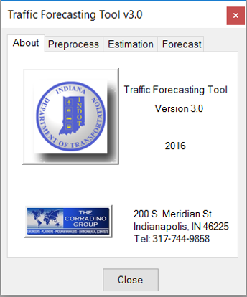
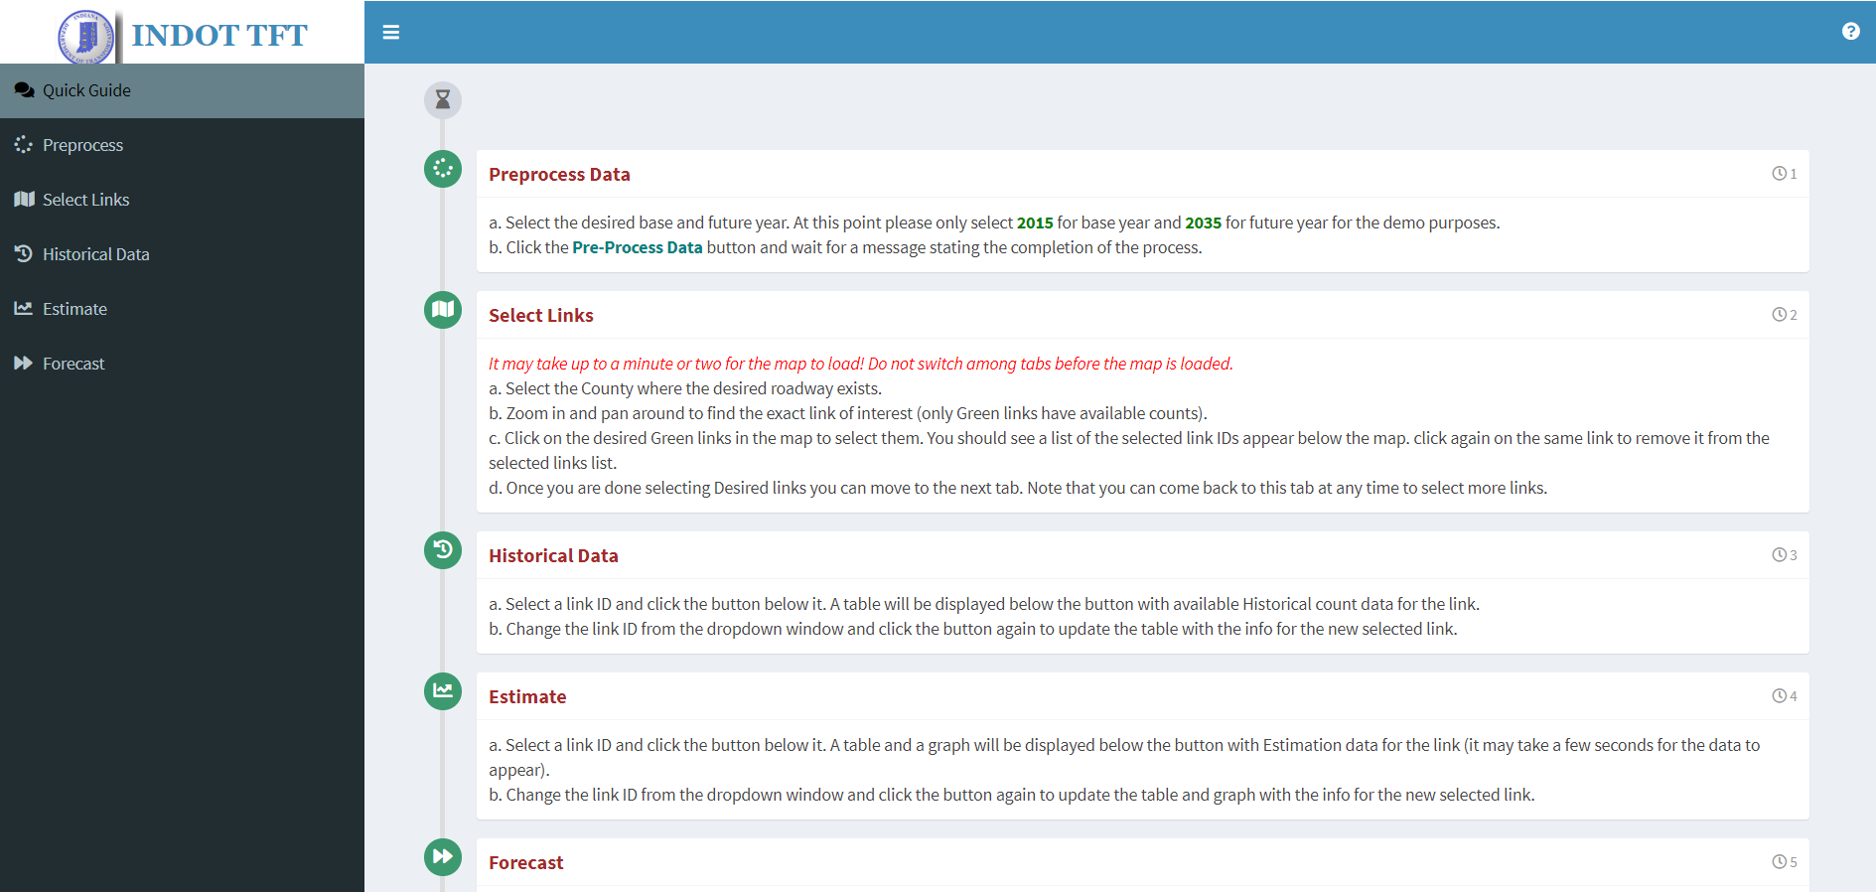
What is TFT ?
A customized application to facilitate State DOT’s long-range traffic forecasting activities at project level.

Slide 3
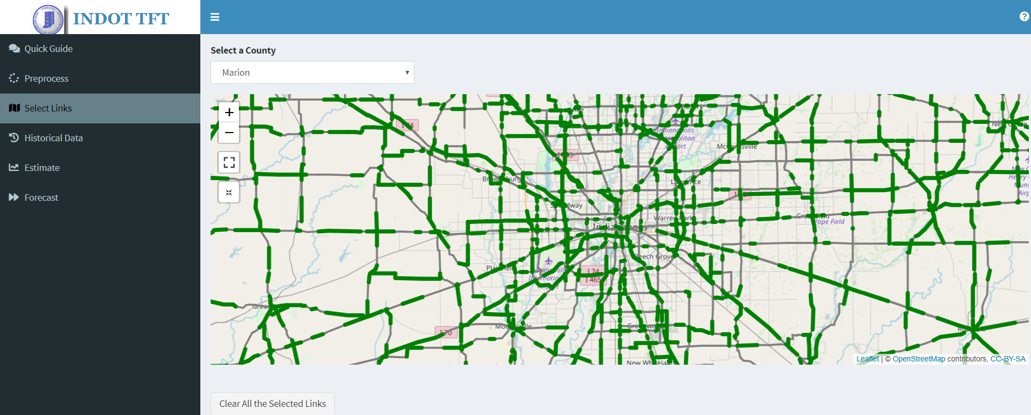
How TFT Evolves …
INDOT TFT v3
INDOT TFT v4
2018 – present
R version (on-line)
2016 – 2017
TransCAD version

Slide 4
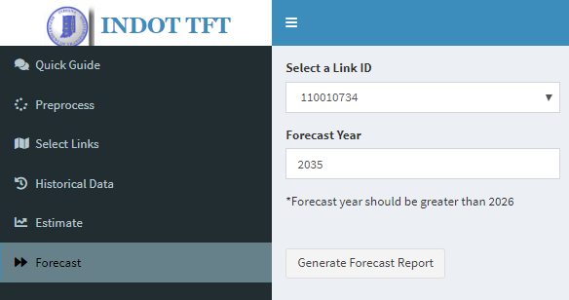
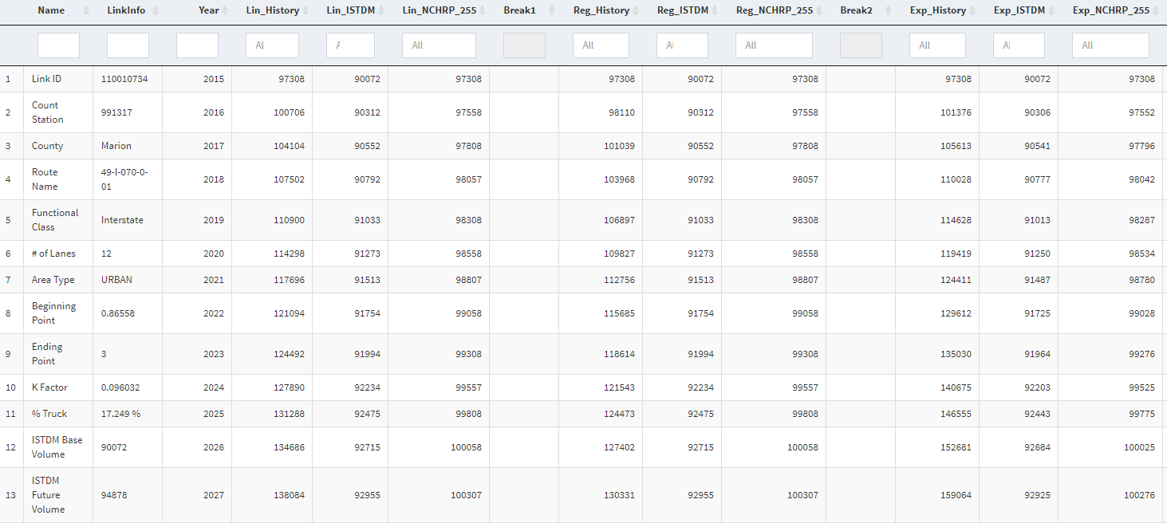
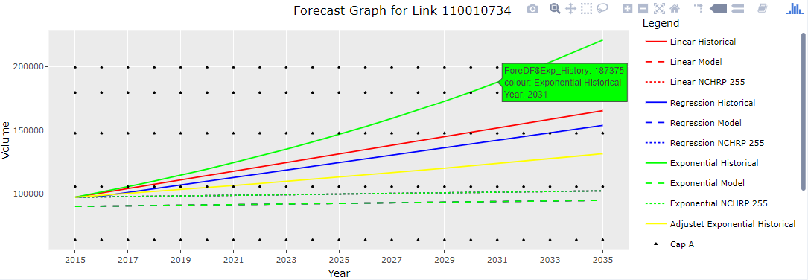
Why ?
An open-source & emerging programming language for travel demand modeling
Efficient data management of multiple links at a time
Powerful graphing capability for better output visualization
“Live” graphs
.HTML output files – extremely convenient for info dissemination
No or minimal software cost
Accessible by anyone (authorized users) and from anytime & anywhere (internet needed)

Slide 5
TFT Fundamentals
Traffic Estimation/Forecast Methods
Linear
Regression
Exponential (Growth Factor)
Adjusted Exponential (Statewide Traffic Growth Profile for IN, KY, TN)
NCHRP 255 calibration
Data Sources
Historical traffic counts (past 15 years)
Statewide model volumes (Base Year & Future Year)
Analysis for multiple links at a time

Slide 6
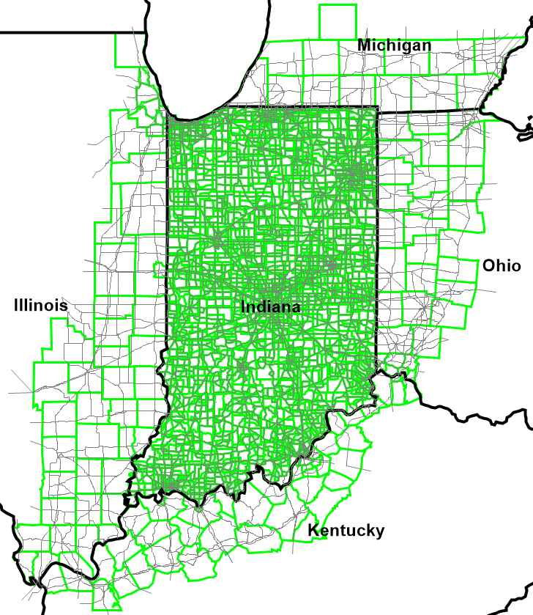
TFT Fundamentals (cont.)
Indiana Statewide Model
4-step model (TransCAD 6)
Coverage – entire IN + partial IL, KY, MI, OH
4879 zones & 46780 links
Modes
auto, freight, LD transit
tolling
Model years 2010 – 2035 with 5-year increment
Currently being updated

Slide 7
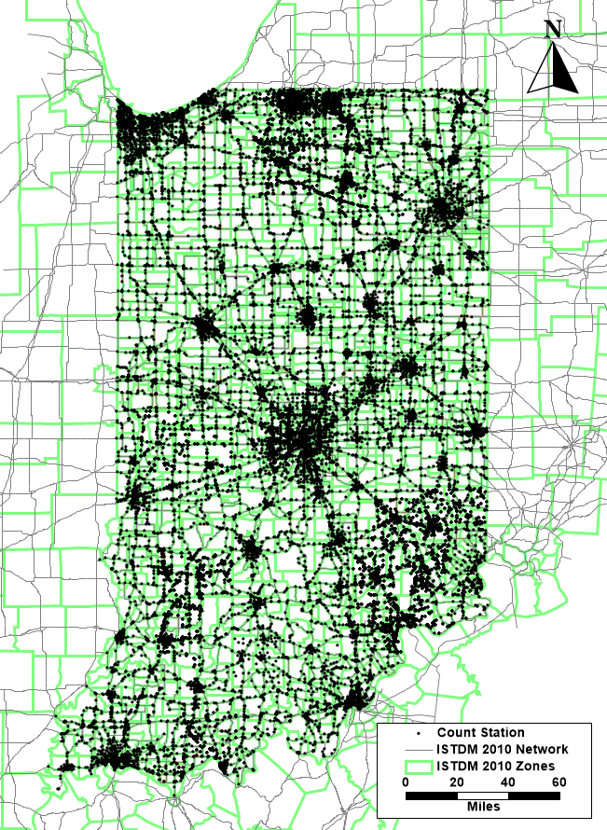
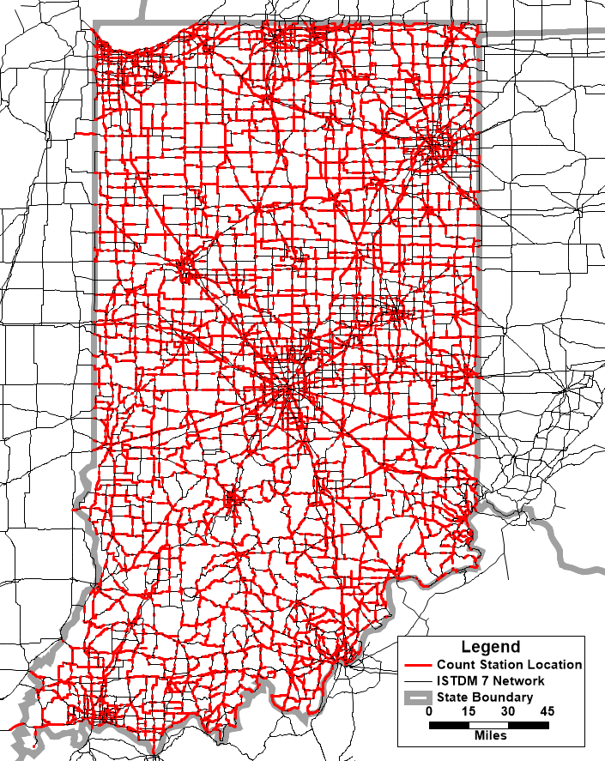
TFT Fundamentals (cont.)
Traffic Data
INDOT’s Traffic Count Database System (TCDS)
Recent AADT counts (2001 – 2015)
Cover all state-owned roadways in TFT v4

Slide 8
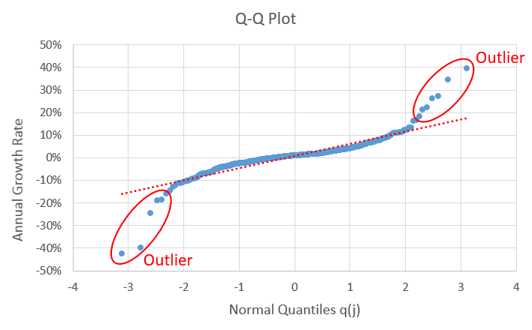
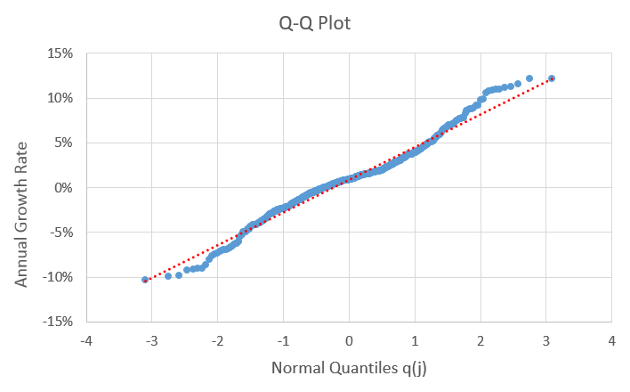
TFT Fundamentals (cont.)
Indiana Traffic Growth Profile
Q-Q Plot for Data Cleaning

Slide 9
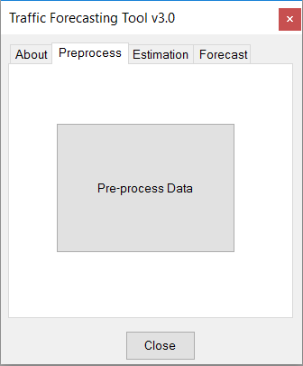
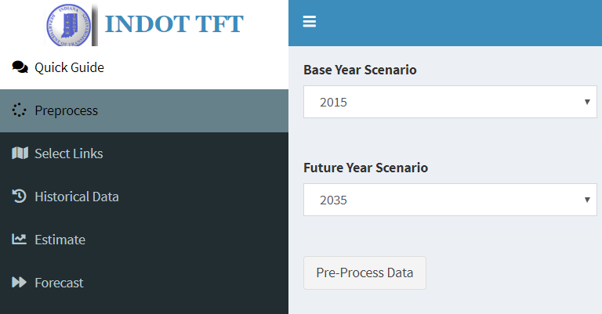
Pre-process
TransCAD Version
R Version
Allow selection of desired scenarios
Join traffic counts with model network (fixed Base & Future scenarios)

Slide 10
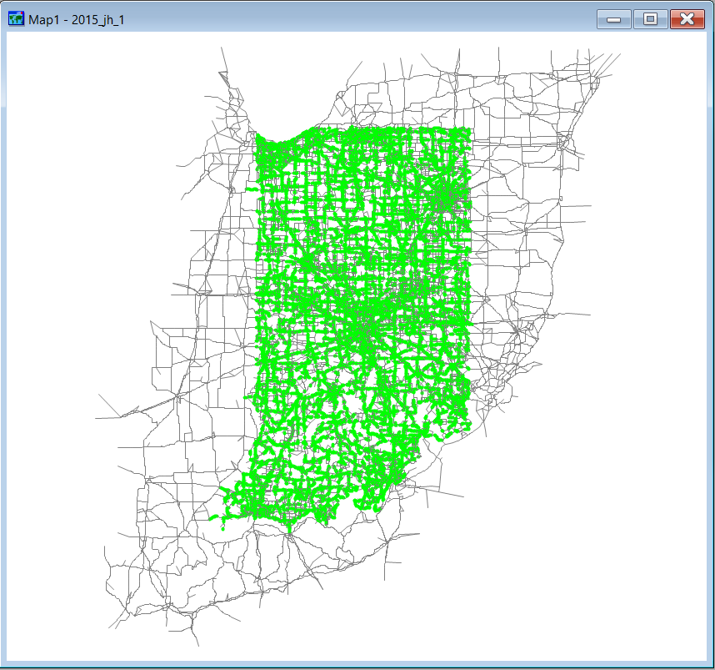
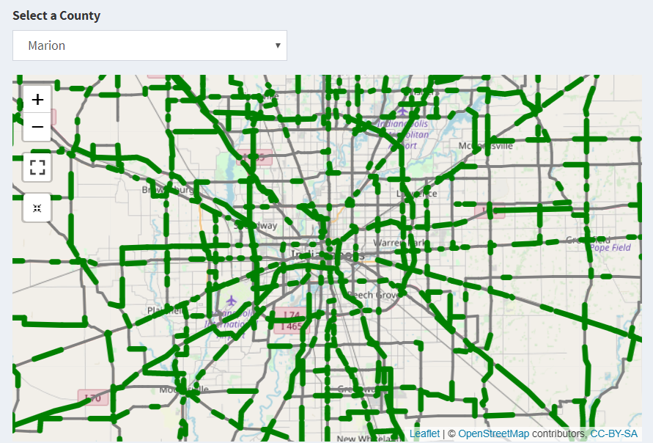
Pre-process (cont.)
TransCAD Version
R Version
Green-highlight links with historical traffic data
R version incorporates OpenStreetMap background for familiarity and enables zoom-in function by selecting county.

Slide 11
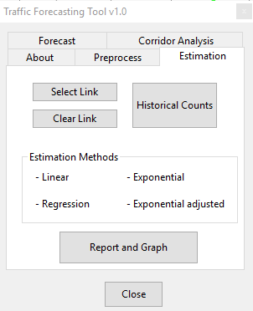
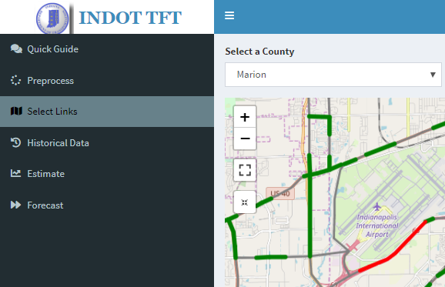
Choose Link
TransCAD Version
R Version
Choose/Clear Link

Slide 12
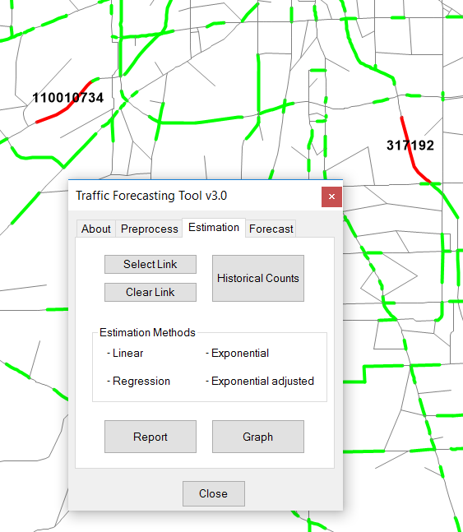
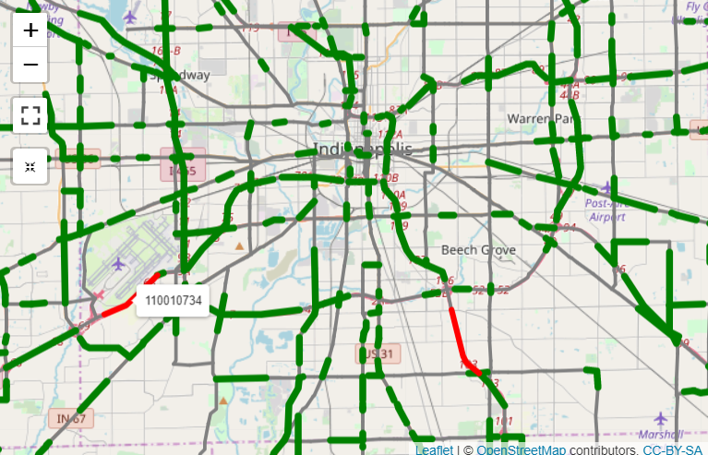
Choose Link (cont.)
TransCAD Version
R Version

Slide 13
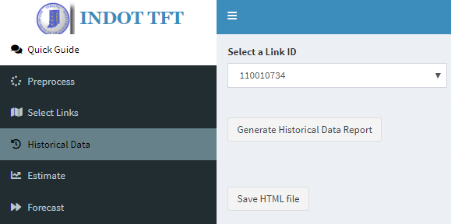
Traffic Counts Reporting
TransCAD Version
R Version
Traffic Counts Reporting

Slide 14
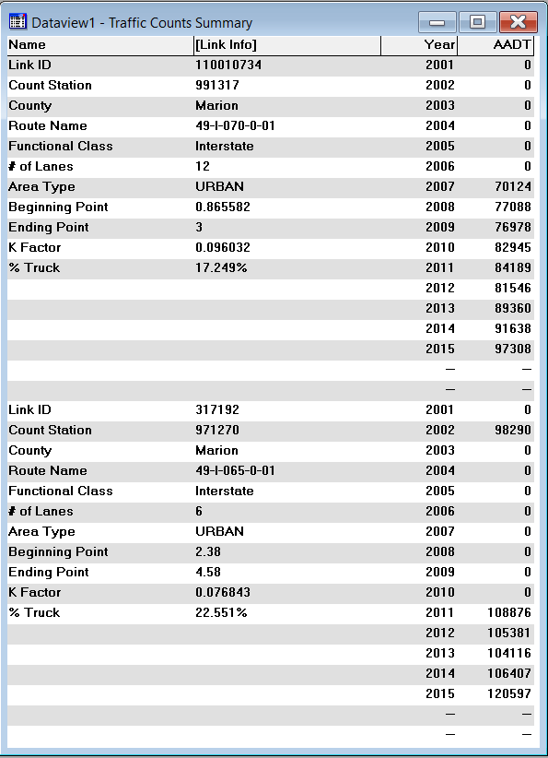
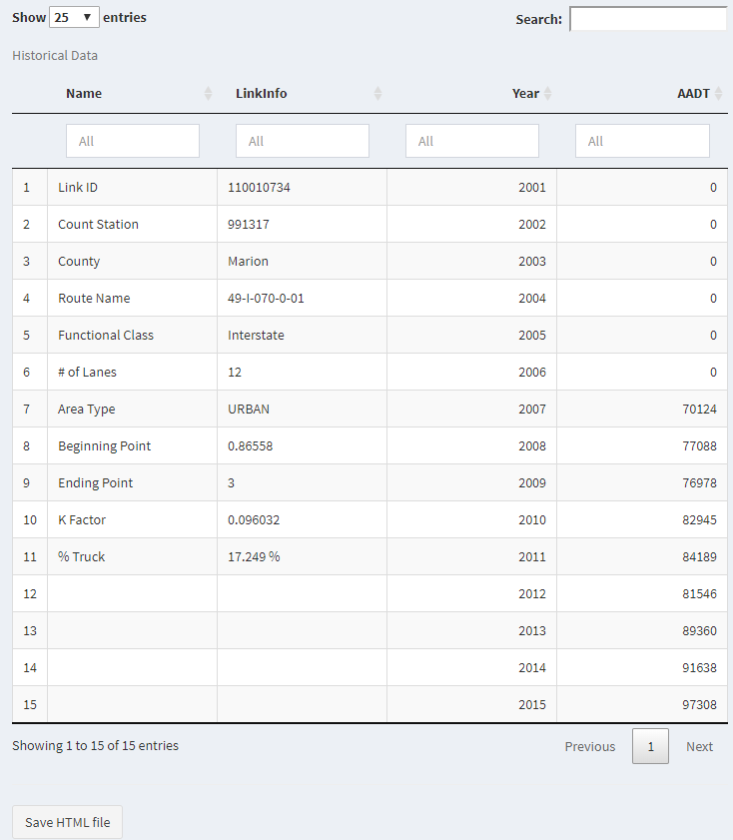
Traffic Counts Reporting (cont.)
TransCAD Version
R Version
Link #1
“Real-time” report by link
Link #2
Save as HTML file

Slide 15
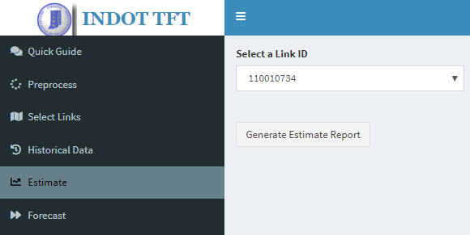
Traffic Estimation
TransCAD Version
R Version
Traffic Estimation Report & Graph

Slide 16
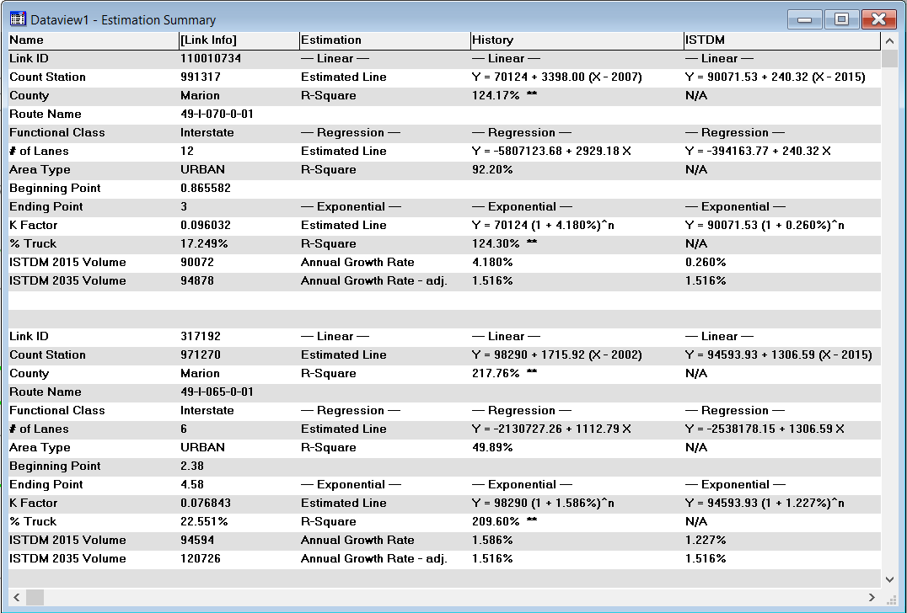
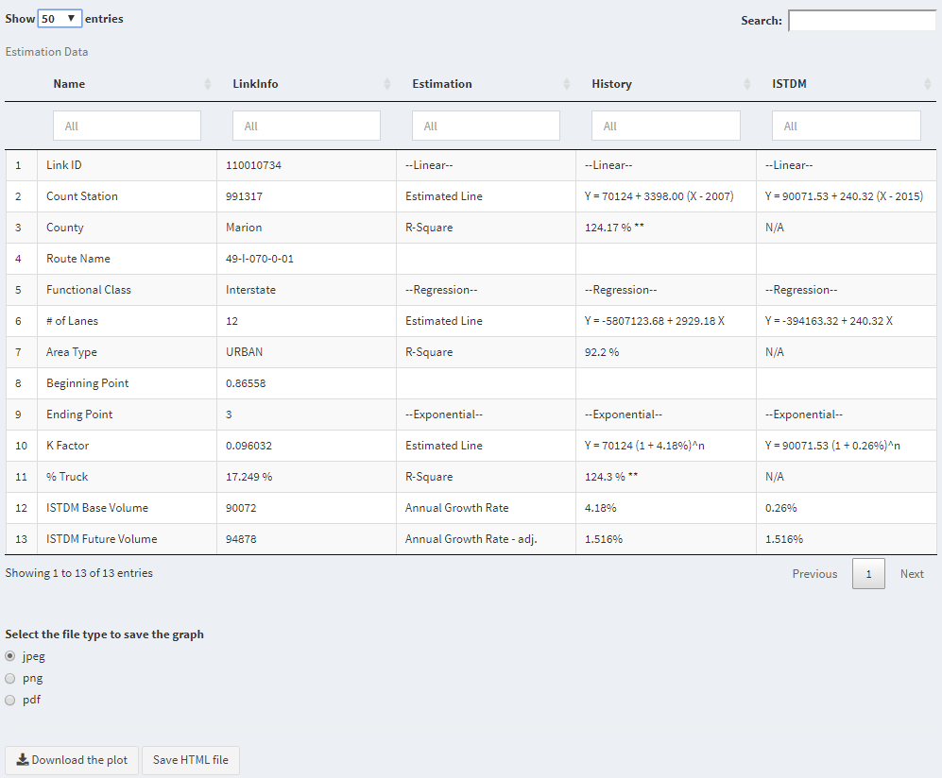
Estimation Report
TransCAD Version
R Version
Link #1
Linear Model
“Real-time” report by link
Reg. Model
Exp. Model
Link #2
Linear Model
Reg. Model
Exp. Model
Save Estimation Graph
Save as HTML file

Slide 17
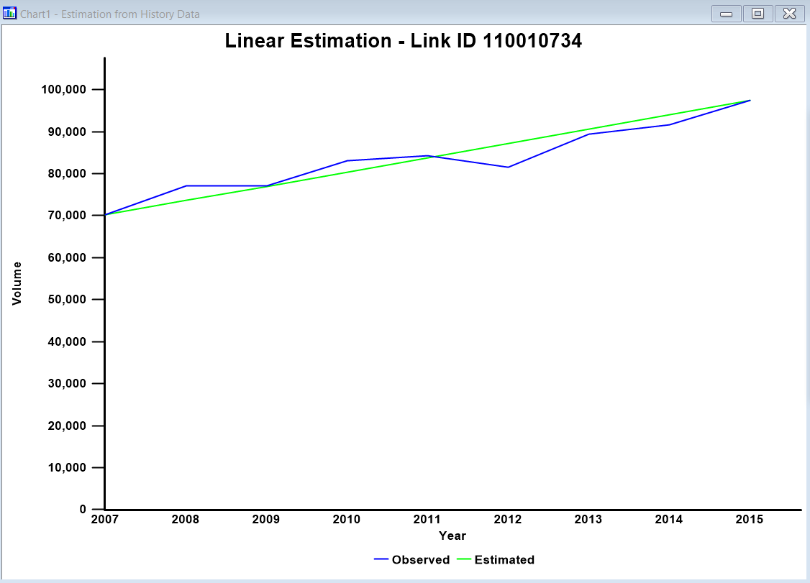
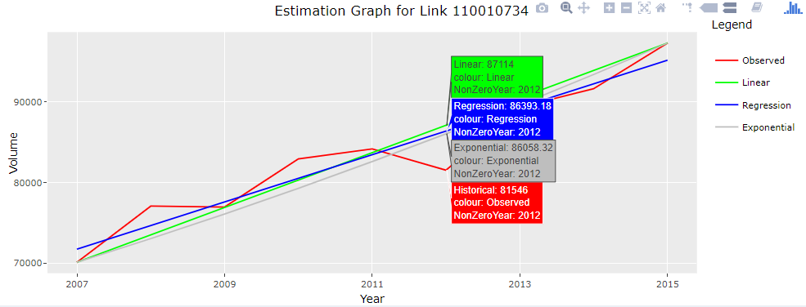
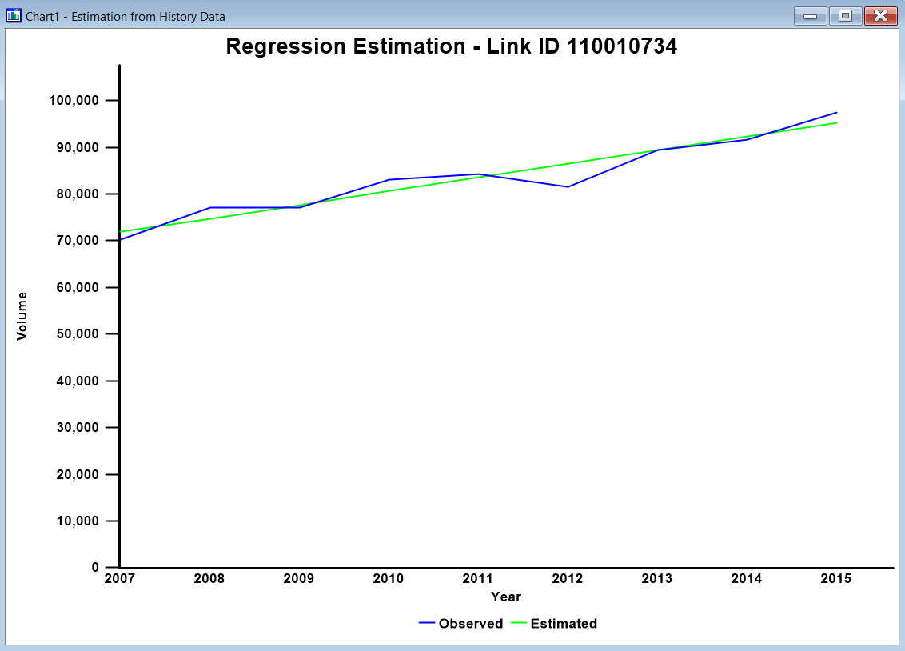
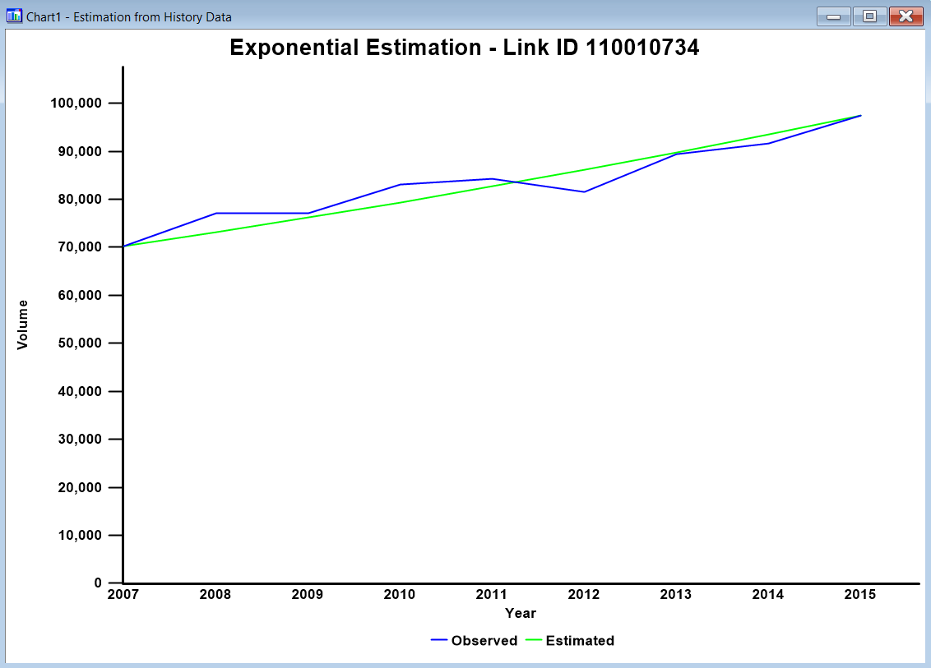
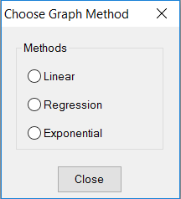
Estimation Graph
TransCAD Version
R Version

Slide 18
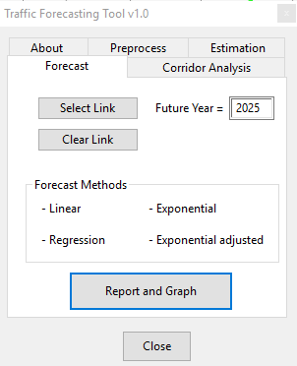
Traffic Forecast
TransCAD Version
R Version
Target year for forecast reporting
Target year for forecast reporting
Traffic Forecast Report & Graph

Slide 19
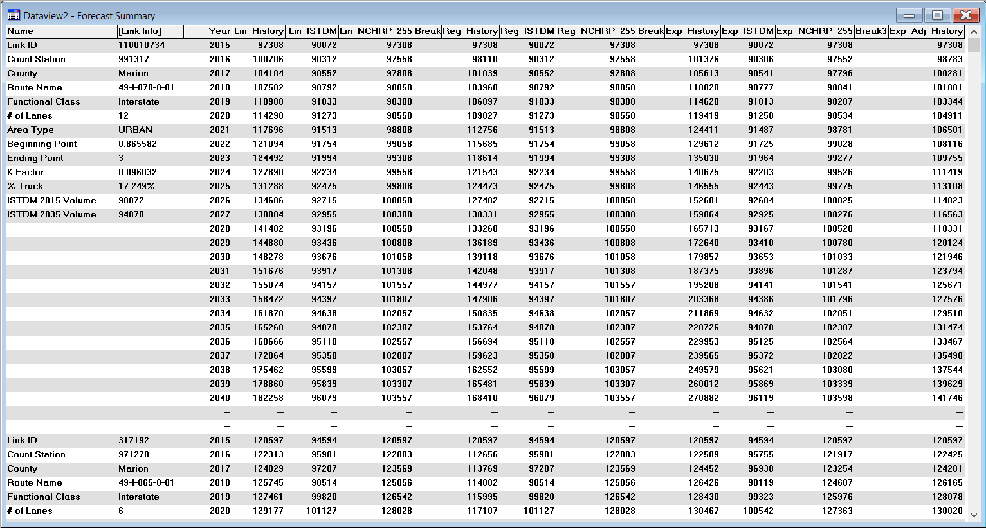
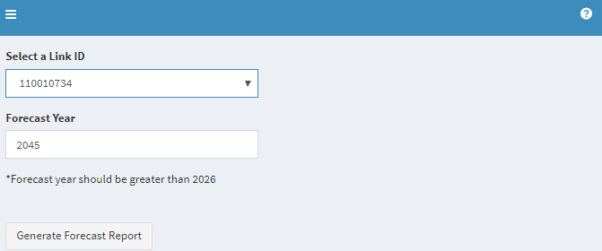
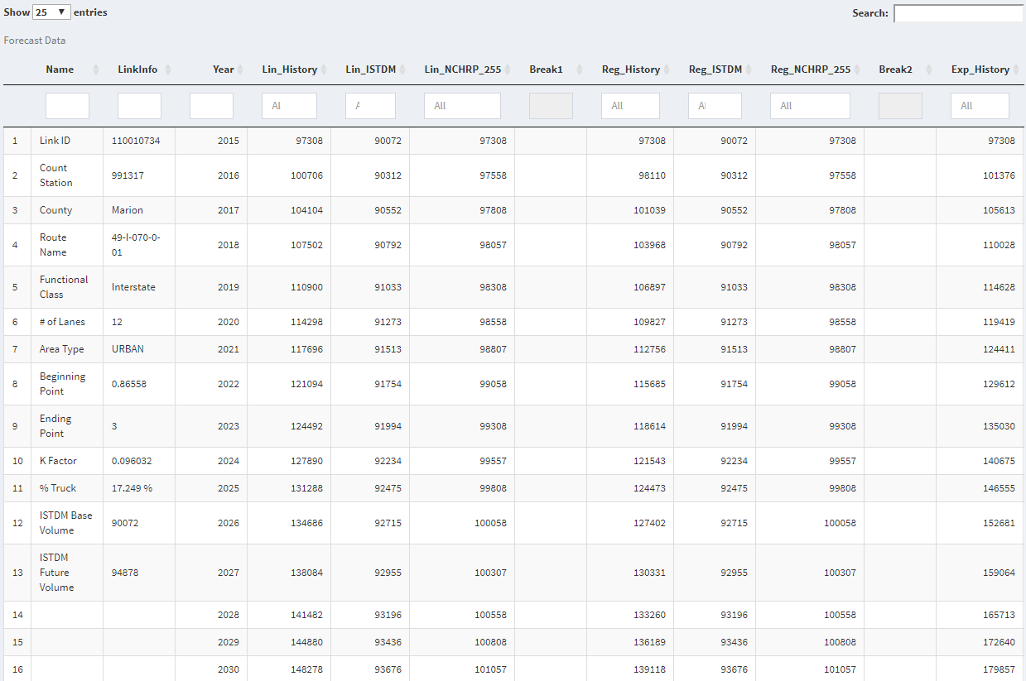
Forecast Report
TransCAD Version
Adj. Exp.
R Version
Link #1
Linear
Reg.
Exp.
“Real-time” report by link
Link #2

Slide 20
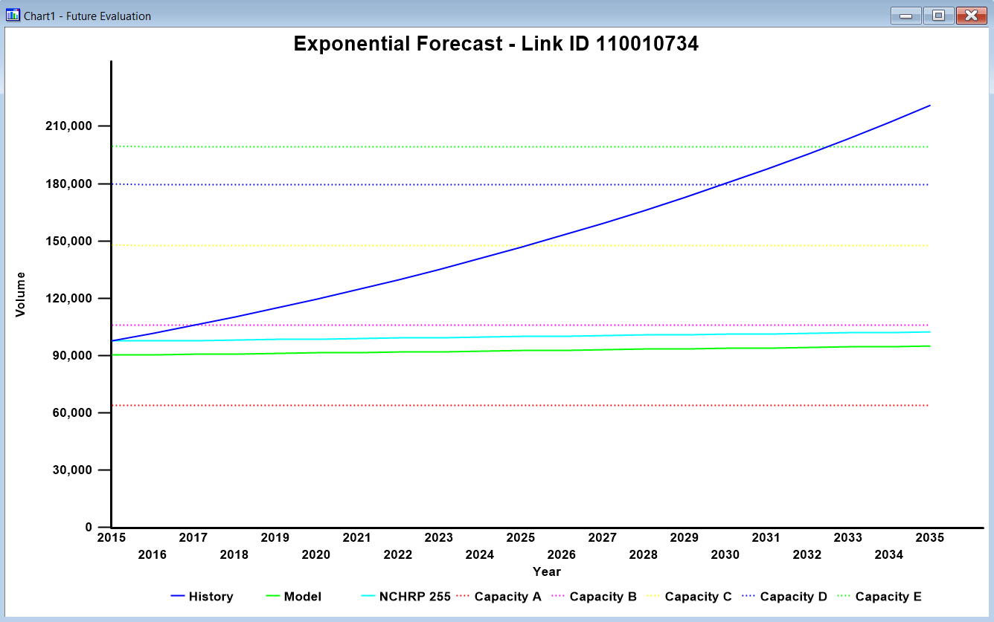
Forecast Graph
TransCAD Version
Based on traffic counts & ISTDM
Various forecasting methods
Forecasts refined by NCHRP 255 & Indiana Traffic Growth Profile
Capacities of LOS A – E
R Version

Slide 21
In Progress …
New Corridor Analysis function (to report fundamental statistics of selected corridor)
Complete coverage of all state-owned roadways
Enhanced visualization in R version

Slide 22
Contact:
Johnny Han, PhD, PE
Technical Vice President
jhan@corradino.com
317.744.9858
www.corradino.com

